Slide 1
INSE - 6180 Project Presentation Sentiment Analysis of User Generated Online Content to Detect Suicidal Tendencies
By:
Vasu Jain Simran Sidhu Mandeep Kaur
S_Id - 40057063 S_Id - 40011611 S_Id - 40059801
v_ja@encs.concordia.ca s_idhu@encs.concordia.ca k_ndeep@encs.concordia.ca

Slide 2

Problem Statement
To detect suicidal ideation by processing the post uploaded by users on the Internet.
Comparison of supervised learning algorithms for text classification

Slide 3
Proposed Model
Data Collection
Tweets
Data Preprocessing
Removal of Stop words
Tokenization
Classifier
Naïve Bayes
Support Vector Machine
Rocchio Algorithm
Stemming
Data Cleaning
Feature Extraction
TF-IDF Matrix
Term-Document Matrix(TDM)
Input Dataset
Result
Analysis

Slide 4

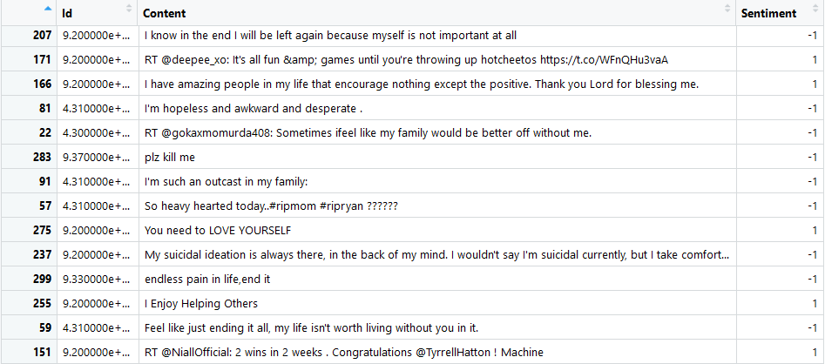
Data Collection

Slide 5
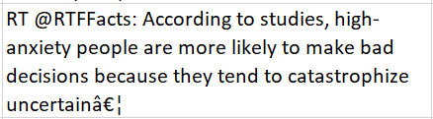
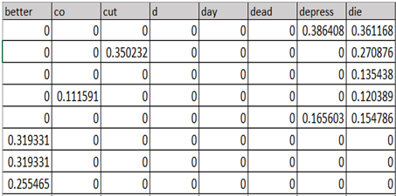
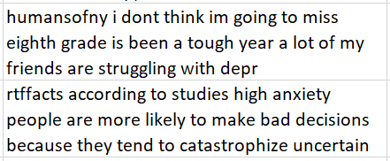

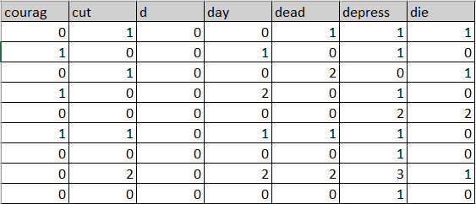
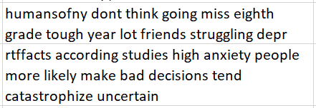
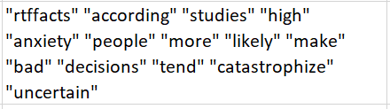
Data Preprocessing & Feature Extraction
Term Frequency-Inverse Document Frequency
(TF-IDF)
Feature Extraction
Original Tweets
Stemming
Term Document Matrix (TDM)
Data Cleaning
Tokenization
Removal of Stopwords

Slide 6
Algorithms Used
Naïve Bayes
(Maximum a posteriori)
Simple, fast and easy to implement.
Highly scalable and leads to good performance.
Takes features as bag of words.
Confusion Matrix
TF-IDF |  | Suicide | Non-Suicide
 | Suicide | 18 | 2
 | Non-Suicide | 0 | 11
TDM | Suicide | 18 | 13
 | Non-Suicide | 1 | 7

Slide 7
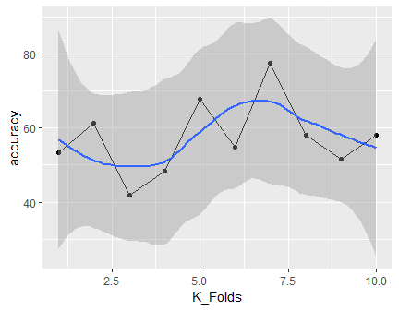
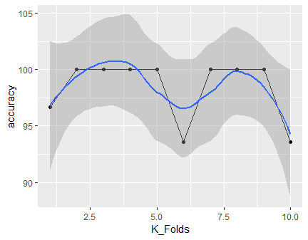
Accuracy Analysis
TF-IDF: 10-fold Accuracy
TDM: 10-fold Accuracy

Slide 8
Algorithms Used
Support Vector Machine
(using Stochastic Gradient Descent)
Well suited for high dimensional and large amount of data
Fast computation
High accuracy
Confusion Matrix
TF-IDF |  | Suicide | Non-Suicide
 | Suicide | 20 | 1
 | Non-Suicide | 3 | 7
TDM | Suicide | 16 | 7
 | Non-Suicide | 1 | 7

Slide 9
Algorithms Used
Nearest Neighbor
(Rocchio Algorithm)
Useful for non-linear data.
Relatively high accuracy
Easy to understand and interpret
Confusion Matrix
TF-IDF |  | Suicide | Non-Suicide
 | Suicide | 174 | 19
 | Non-Suicide | 9 | 107
TDM | Suicide | 137 | 23
 | Non-Suicide | 40 | 109

Slide 10
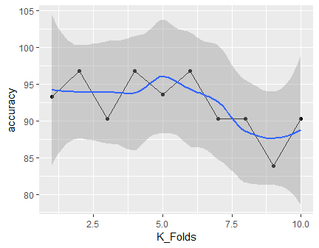
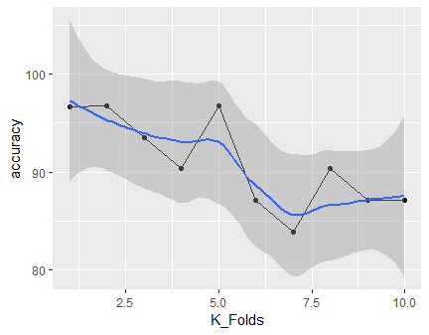
Accuracy Analysis
TF-IDF: 10-fold Accuracy
TDM: 10-fold Accuracy

Slide 11
Performance Comparison
Classifiers | Features | Accuracy | Precision | Recall | Specificity | F1 Score
Naïve Bayes | TF-IDF | 98.3 | 90.00 | 100.00 | 84.61538 | 94.736
 | TDM | 57.2 | 58.064 | 100.00 | 0 | 73.469
Support Vector Machine (SVM) | TF-IDF | 87.096 | 95.238 | 86.956 | 86.956 | 90.909
 | TDM | 74.193 | 69.565 | 94.117 | 50.000 | 80.000
Rocchio Algorithm | TF-IDF | 91.0 | 90.155 | 95.081 | 84.920 | 92.553
 | TDM | 79.6 | 85.625 | 77.401 | 82.575 | 81.305

Slide 12
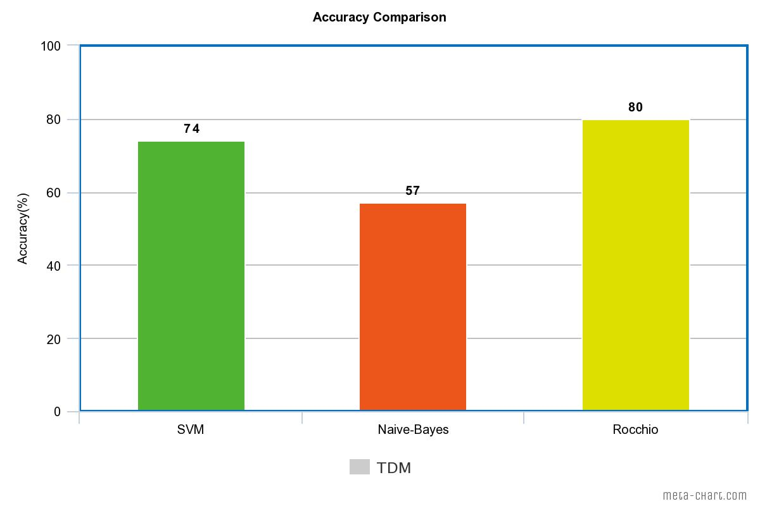
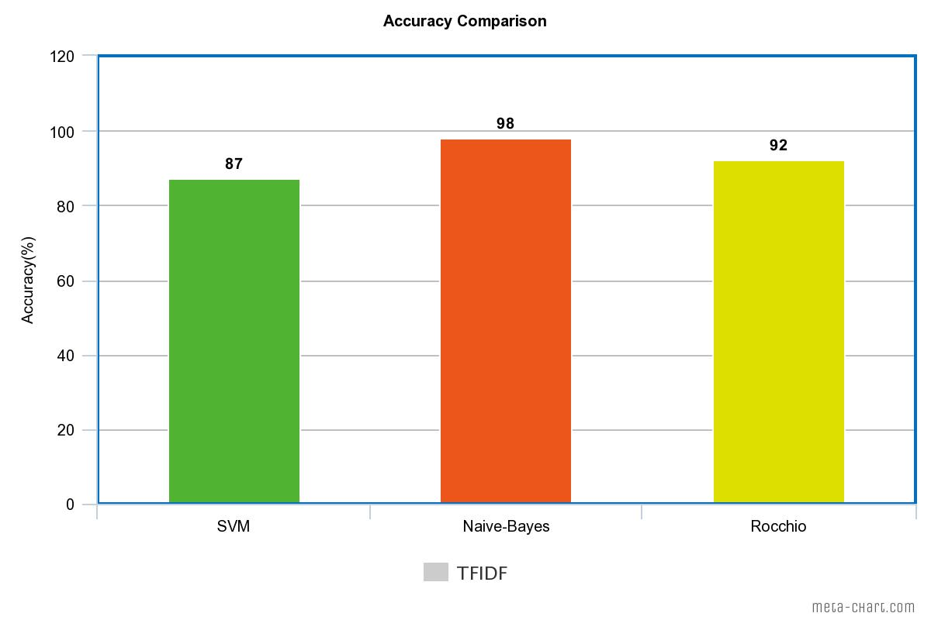
Performance Comparison

Slide 13
Conclusion
Naïve-Bayes gave the best performance for TF-IDF feature set. It reaffirms the importance of probabilistic view for text classification.
Accuracies for TF-IDF outperforms that for TDM feature set indicating that relative term frequency and Inverse document frequency is a better measure of similarities in texts.
As per the results, count of False-Negatives is less than False-Positives for most of the algorithms indicating lesser count of suicidal tweets classified as non-suicidal.

Slide 14
Research Papers Referred
Supervised Learning for Suicidal Ideation Detection in Online User Content Shaoxiong Ji, Celina Ping Yu, Sai-fu Fung, Shirui Pan, and Guodong Long, “Supervised Learning for Suicidal Ideation Detection in Online User Content,” Complexity, vol. 2018, Article ID 6157249, 10 pages, 2018. https://doi.org/10.1155/2018/6157249
P. Burnap, W. Colombo, and J. Scourfield. Machine classification and analysis of suicide-related communication on Twitter. In Proceedings of the 26th ACM Conference on Hypertext & Social Media, pages 75–84. ACM, 2015
Birjali, M., Beni-hssane, A., & MohammedErritali (2016). Prediction of Suicidal Ideation in Twitter Data using Machine Learning algorithms.

Slide 15
THANK YOU!
Any questions???

